Slide 1

CSC- 362 Computer Networks
Week-2 Lecture- 3 & 4
                Prepared by:
                Mr. Attique Ur Rehman

Slide 2
Instructor Contact Details
Name: Mr. Mumtaz Ahmad
Course Instructor: CSC362- Computer Networks
Credit Hours: (3+1)=4
Office Location: 2nd Floor MaleFaculty
Email: cs.mumtaz@lgu.edu.pk
Visiting Hours: Wednesday (11:30 am -1:00 pm)

Slide 3
Course Material
Reference books
Many textbooks on Networking may be consulted
Research papers!
RFCs and Internet drafts
  Related to TCP/IP suite and other protocols
Web resources
  Tutorials, white papers, reports, etc.

Slide 4
Chapter 2
Network Models

Slide 5
Outline
THE NEED FOR STANDARDS
LAYERED TASKS
ISO - ORGANISATION FOR STANDARDISATION
THE OSI (Open System Interconnection ) REFERENCE MODEL
TCP/IP PROTOCOL SUITE
SUMMARY

Slide 6
THE NEED FOR STANDARDS
Over the past couple of decades many of the networks that were built used different hardware and software implementations, as a result they were incompatible and it became difficult for networks using different specifications to communicate with each other.
To address the problem of networks being incompatible and unable to communicate with each other, the International Organisation for Standardisation (ISO) researched various network schemes.
The ISO recognised there was a need to create a NETWORK MODEL that would help vendors create interoperable network implementations.

Slide 7
LAYERED TASKS
We use the concept of layers in our daily life. Example:
let us consider two friends who communicate through postal mail. The process of sending a letter to a friend would be complex if there were no services available from the post office
Sender
Receiver
Carrier
Hierarchy
Services

Slide 8
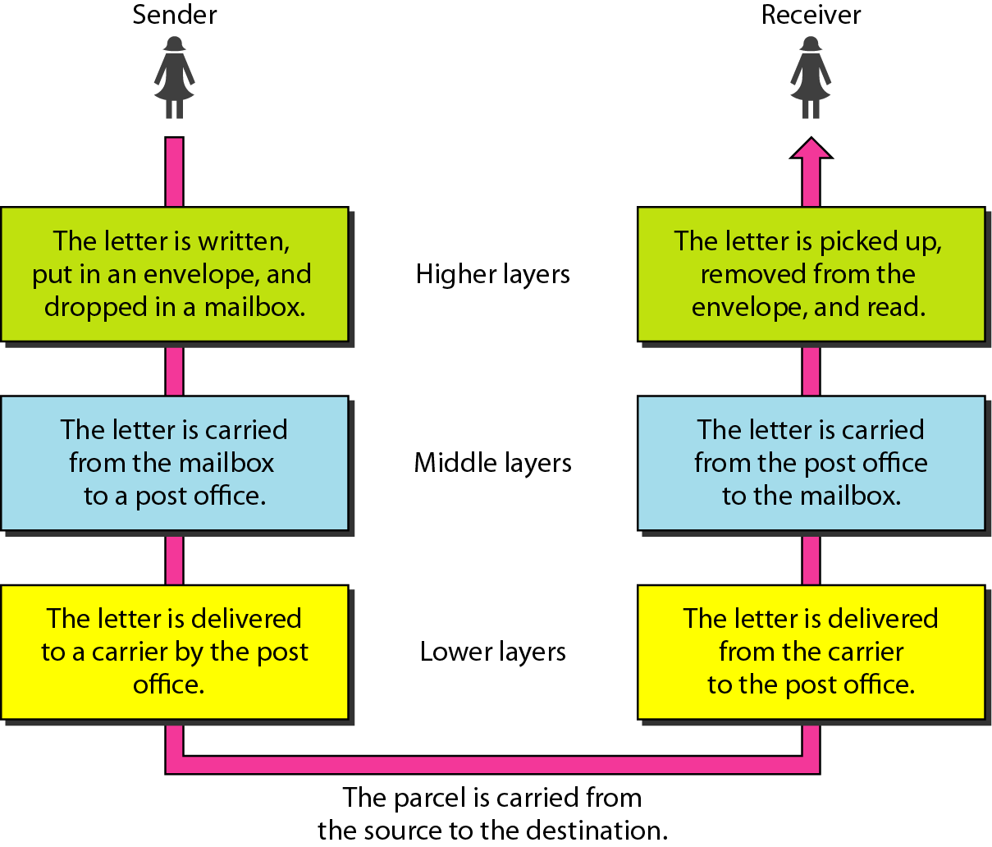
Tasks involved in sending a letter

Slide 9

ISO
ORGANISATION FOR STANDARIZATION
The International Organisation for Standardisation (ISO) is an International standards organisation responsible for a wide range of standards, including many that are relevant to networking.
In 1984 in order to aid network interconnection without necessarily requiring complete redesign, the Open Systems Interconnection (OSI) reference model was approved as an international standard for communications architecture.

Slide 10
THE OSI REFERENCE MODEL
The model was developed by the International Organisation for Standardisation (ISO) in 1984. It is now considered the primary Architectural model for inter-computer communications.
The Open Systems Interconnection (OSI) reference model is a descriptive network scheme. It ensures greater compatibility and interoperability between various types of network technologies.
The OSI model describes how information or data makes its way from application programmes (such as spreadsheets) through a network medium (such as wire) to another application programme located on another network.

Slide 11
THE OSI REFERENCE MODEL
The OSI reference model divides the problem of moving information between computers over a network medium into SEVEN smaller and more manageable problems .
This separation into smaller more manageable functions is known as layering.

Slide 12
THE OSI REFERENCE MODEL
The OSI Reference Model is composed of seven layers, each specifying particular network functions.
The process of breaking up the functions or tasks of networking into layers reduces complexity.
Each layer provides a service to the layer above it in the protocol specification.
Each layer communicates with the same layer’s software or hardware on other computers.

Slide 13
THE OSI REFERENCE MODEL
The lower 4 layers (transport, network, data link and physical —Layers 4, 3, 2, and 1) are concerned with the flow of data from end to end through the network.
The upper three layers of the OSI model (application, presentation and session—Layers 7, 6 and 5) are orientated more toward services to the applications.
Data is Encapsulated with the necessary protocol information as it moves down the layers before network transit.

Slide 14
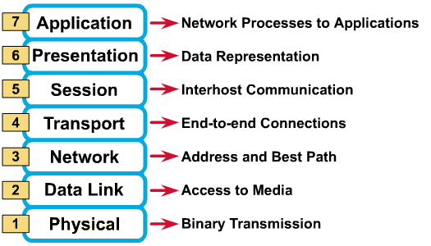
THE OSI REFERENCE MODEL

Slide 15
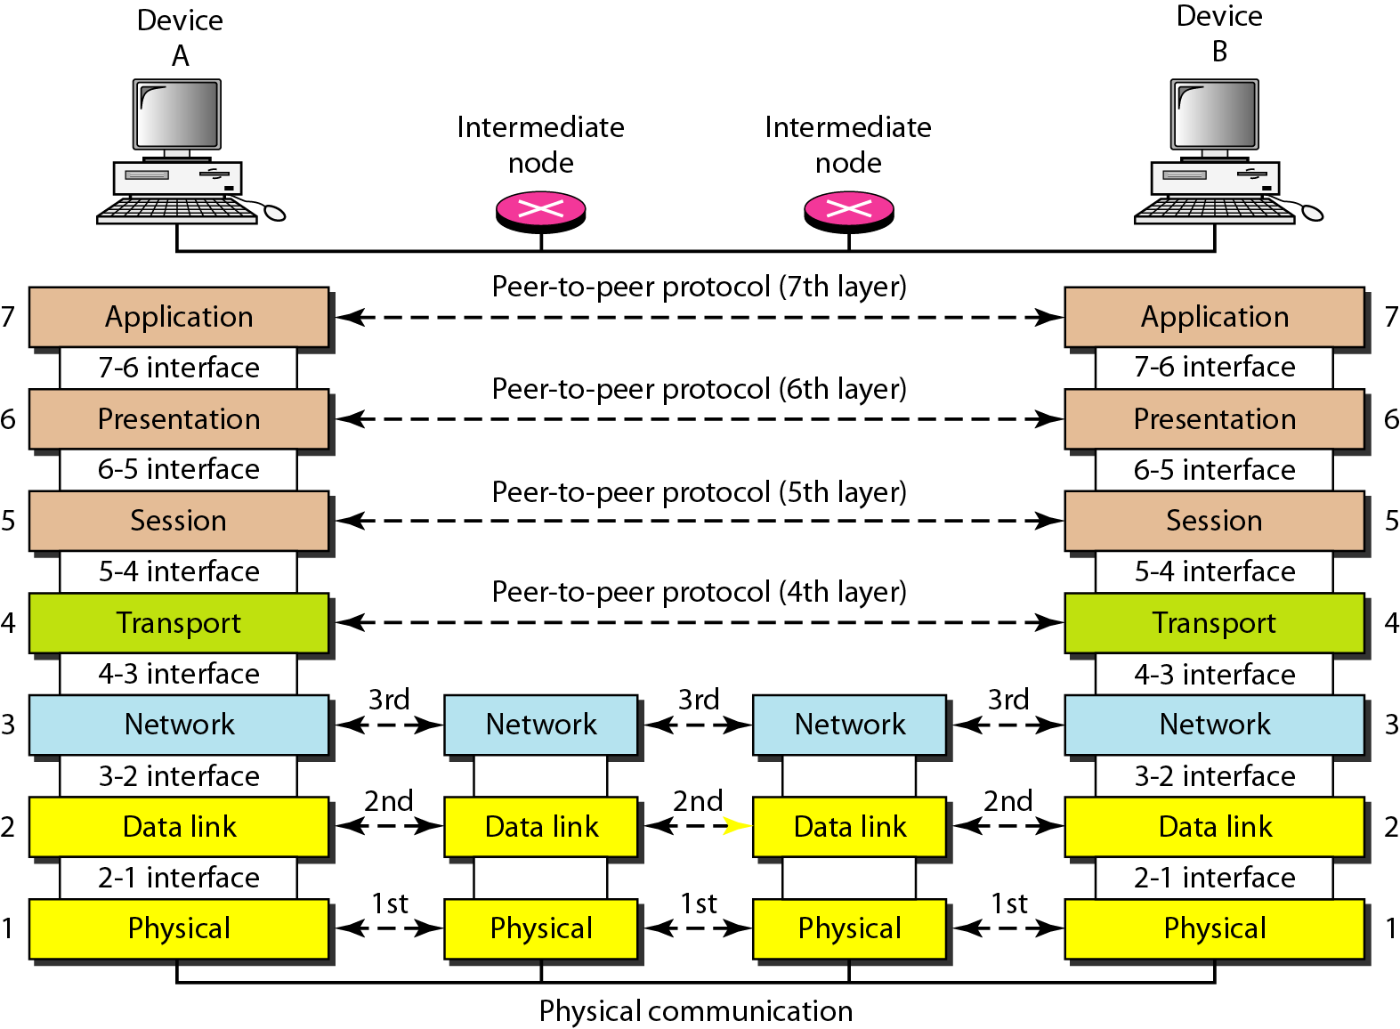
The interaction between layers in the OSI model

Slide 16
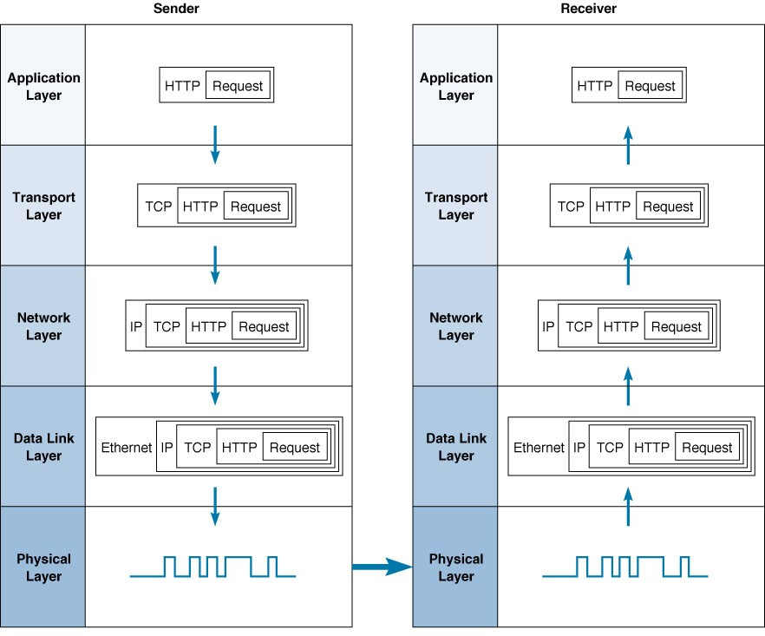
An exchange using the OSI Model

Slide 17
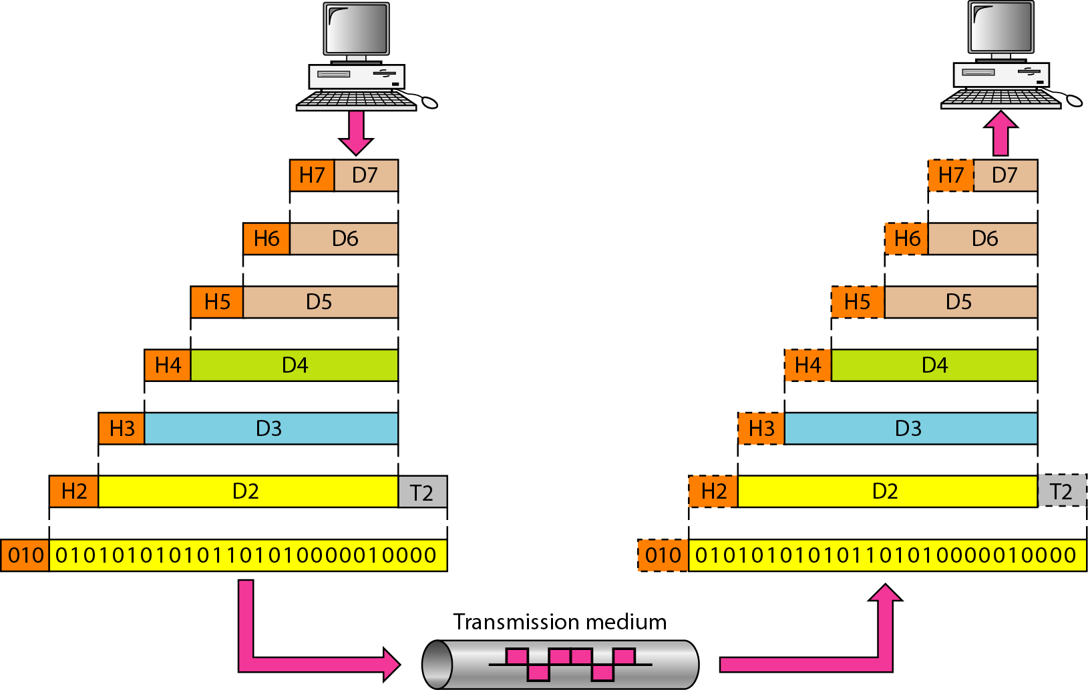
An exchange using the OSI model

Slide 18
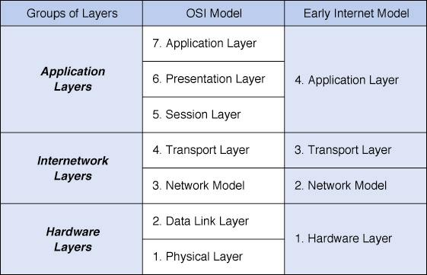
NETWORK MODELS

Slide 19
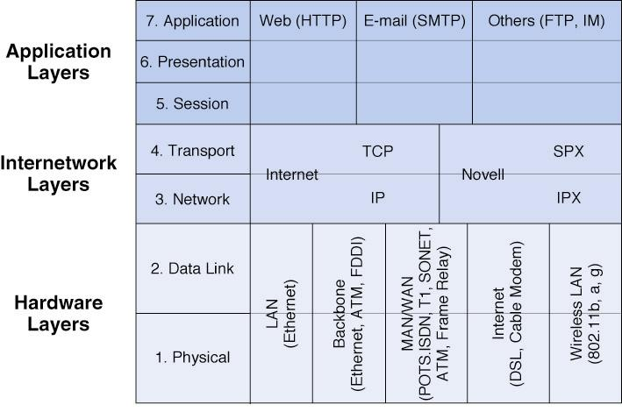
HOW LAYERS FIT TOGATHER IN PRACTIC

Slide 20
PROTOCOL ACRONYMS
(T)FTP – (Trivial) File Transfer Protocol
HTTP – Hyper Text Transport Protocol
NV – Network Video
SMTP – Simple Mail Transfer Protocol
NTP – Network Time Protocol
TCP – Transmission Control Protocol
UDP – User Datagram Protocol
IP – Internet Protocol
FDDI – Fiber Distributed Data Interface
ATM – Asynchronous Transfer Mode

Slide 21
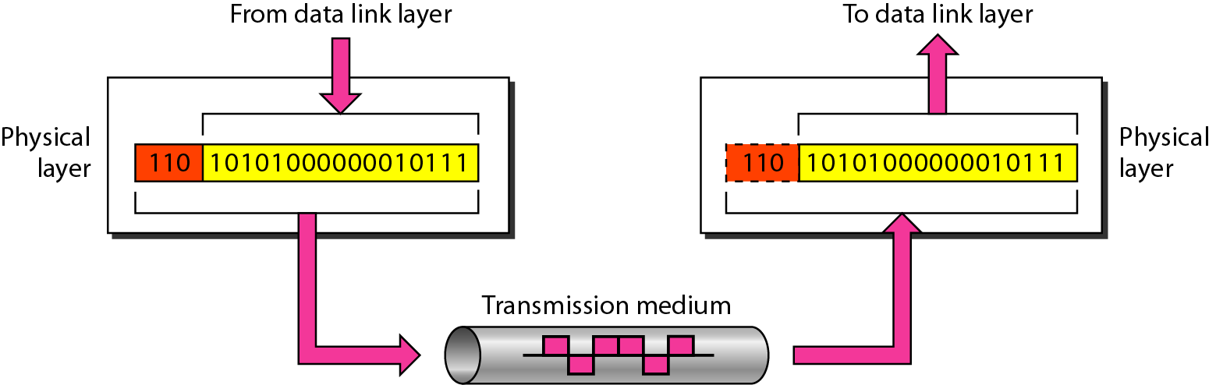
LAYER 1: PHYSICAL
The physical layer is responsible for movements of
individual bits from one hop (node) to the next.

Slide 22
LAYER 1: PHYSICAL
The physical layer deals with the physical characteristics of the transmission medium.
It defines the electrical, mechanical, procedural, and functional specifications for activating, maintaining, and deactivating the physical link between end systems.

Slide 23
LAYER 1: PHYSICAL
Such characteristics as voltage levels, timing of voltage changes, physical data rates, maximum transmission distances, physical connectors, and other similar attributes are defined by physical layer specifications.
Passive hub, simple active hubs, terminators, cables and cabling connectors, repeaters, multiplexers, transmitters, receivers, and transceivers are devices associated with the physical layer.

Slide 24
LAYER 1: PHYSICAL
The Physical layer is also concerned with the following
The Physical characteristics of Interface and medium:
  Defines
    Characteristics of the interface between devices and transmission medium
    The type of transmission mediums
Network connection types/Line configuration:
  Concern with the connection of devices with media
    including multipoint and point-to-point connection

Slide 25
LAYER 1: PHYSICAL
Representation of bits / Analog and digital signaling:
  Define the type of encoding (how 0s and 1s are changed to signals)
Data rate:
  Define transmission rate (the number of bits send each second) or define duration of bit, which is how long it lasts
Synchronization of bits:
  Sender and receiver must use same bit rate or clocks must synchronize

Slide 26
LAYER 1: PHYSICAL
Physical topologies:
  (physical layouts of networks) such as bus, star, or ring
Baseband and broadband transmissions
  which are different methods for using media bandwidth
Multiplexing:
  which involves combining several data channels into one

Slide 27
LAYER 1: PHYSICAL
Termination:
  which prevents signals from reflecting back through the cable and causing signal and packets errors. It also indicates the last node in a network segment
Transmission mode:
  Defines the direction of transmission between two devices
    Simplex, half duplex or full duplex

Slide 28
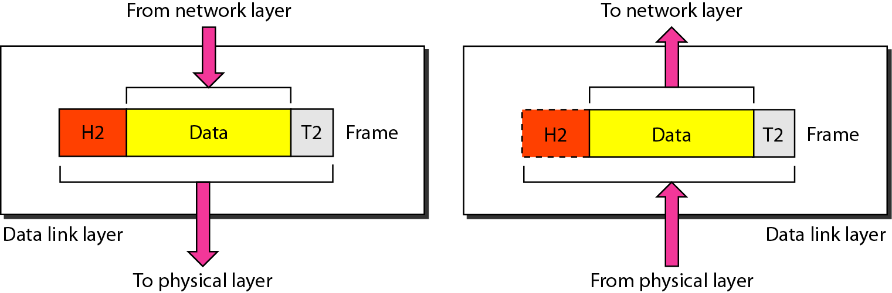
LAYER 2: DATA LINK
The data link layer is responsible for moving
frames from one hop (node) to the next.

Slide 29
LAYER 2: DATA LINK
The data link layer provides access to the networking media and physical transmission across the media and this enables the data to locate its intended destination on a network.
The data link layer provides reliable transit of data across a physical link by using the Media Access Control (MAC) addresses.
The data link layer uses the MAC address (12 -digit hexadecimal) to define a hardware or data link address in order for multiple stations to share the same medium and still uniquely identify each other.

Slide 30
LAYER 2: DATA LINK
Data link layer split into two sub-layer:
Logical Link Control (LLC) ,establishes and maintains links
Media Access Control (MAC) ,controls the way multiple devices share the same media channel
Examples :- Ethernet, Frame Relay, FDDI.

Slide 31
LAYER 2: DATA LINK
Concerned with
  Framing
  Physical addressing
  Network access / Access control
  Error control
    error notification,
    error free (CRC)
  Ordered delivery of frames
  Flow control.

Slide 32
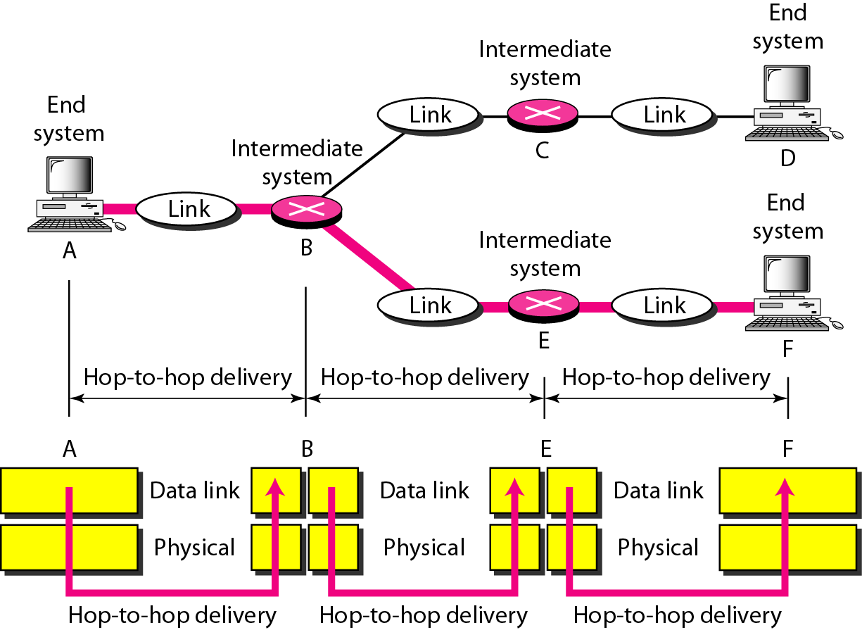
Hop-to-hop delivery

Slide 33
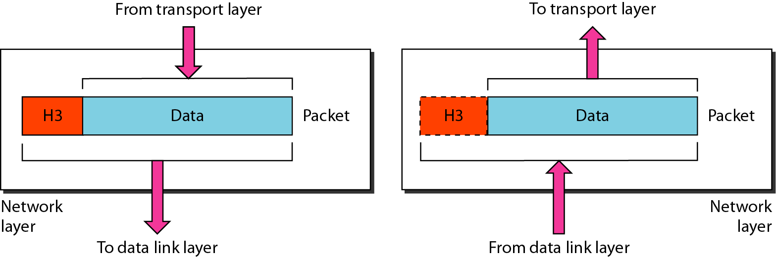
LAYER 3: NETWORK
The network layer is responsible for the
delivery of individual packets from
the source host to the destination host.

Slide 34
LAYER 3: NETWORK
Defines end-to-end delivery of packets.
Defines logical addressing (translates logical network address into physical machine address) so that any endpoint can be identified.
Defines how routing works and how routes are learned so that the packets can be delivered.
Determines the quality of service (priority of the message)

Slide 35
LAYER 3: NETWORK
The network layer also defines how to fragment a packet into smaller packets to accommodate different media.
Segmentation
Routers, Layer 3 Switches
Examples :- IP, IPX, AppleTalk.

Slide 36
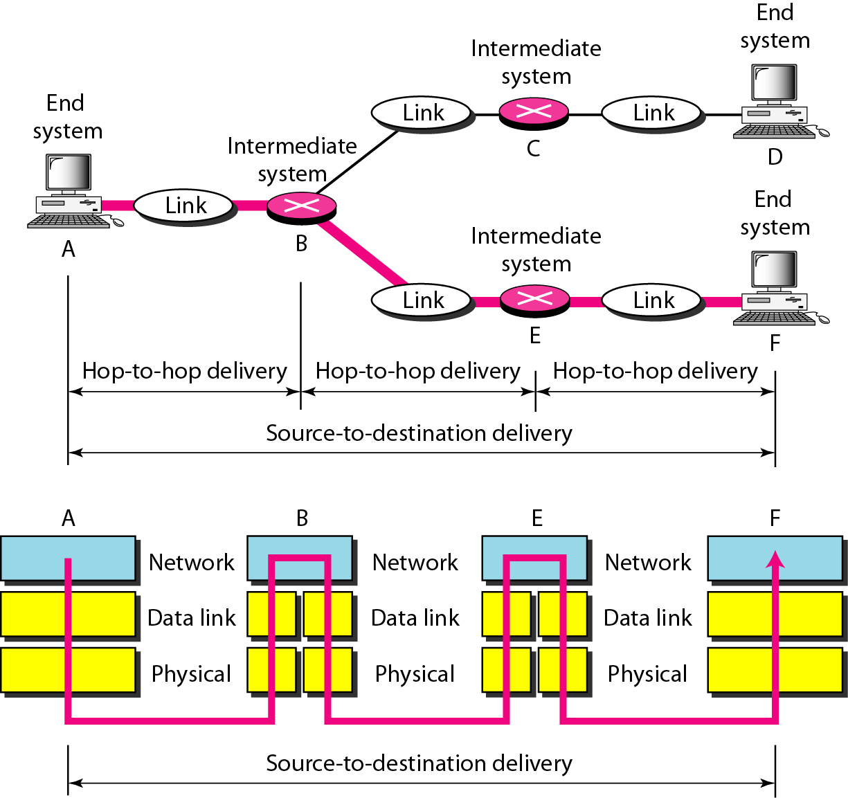
Source-to-destination delivery

Slide 37
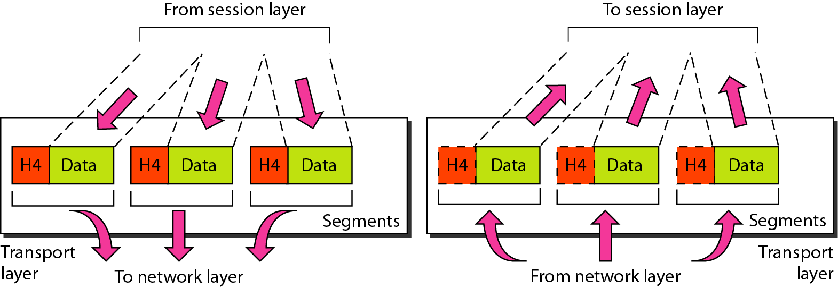
LAYER 4: TRANSPORT
The transport layer is responsible for the delivery
of a message from one process to another.

Slide 38
LAYER 4: TRANSPORT
The transport layer regulates information flow to ensure end-to-end connectivity between host applications reliably and accurately.
The transport layer segments data from the sending host's system and reassembles the data into a data stream on the receiving host's system.

Slide 39
LAYER 4: TRANSPORT
The boundary between the transport layer and the session layer can be thought of as the boundary between application protocols and data-flow protocols. Whereas the application, presentation, and session layers are concerned with application issues, the lower four layers are concerned with data transport issues.
Layer 4 protocols include TCP (Transmission Control Protocol) and UDP (User Datagram Protocol).

Slide 40
LAYER 4: TRANSPORT
Concerned with
  Services point addressing
  Error control
  Connection control
  In Order delivery
  Flow control
  Reassembly

Slide 41
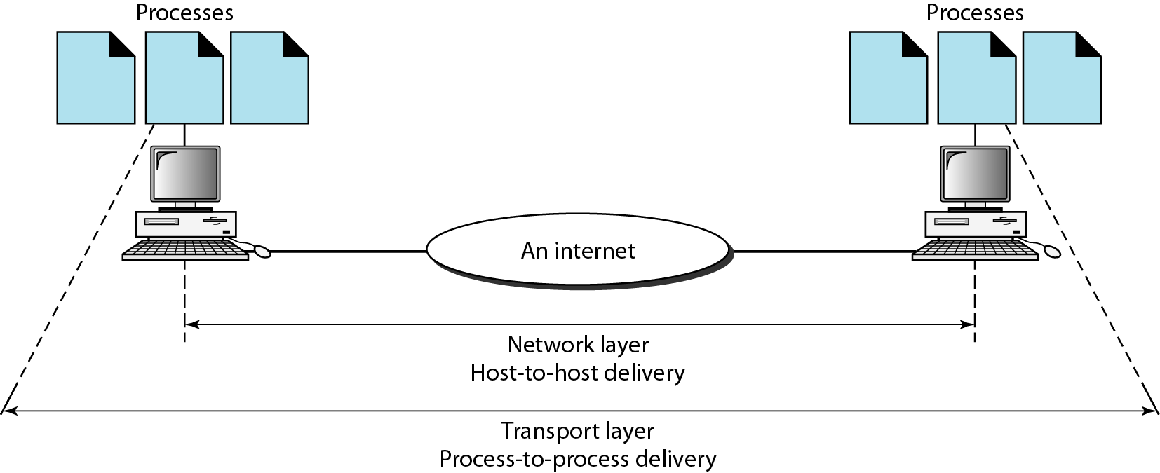
Reliable process-to-process delivery of a message

Slide 42
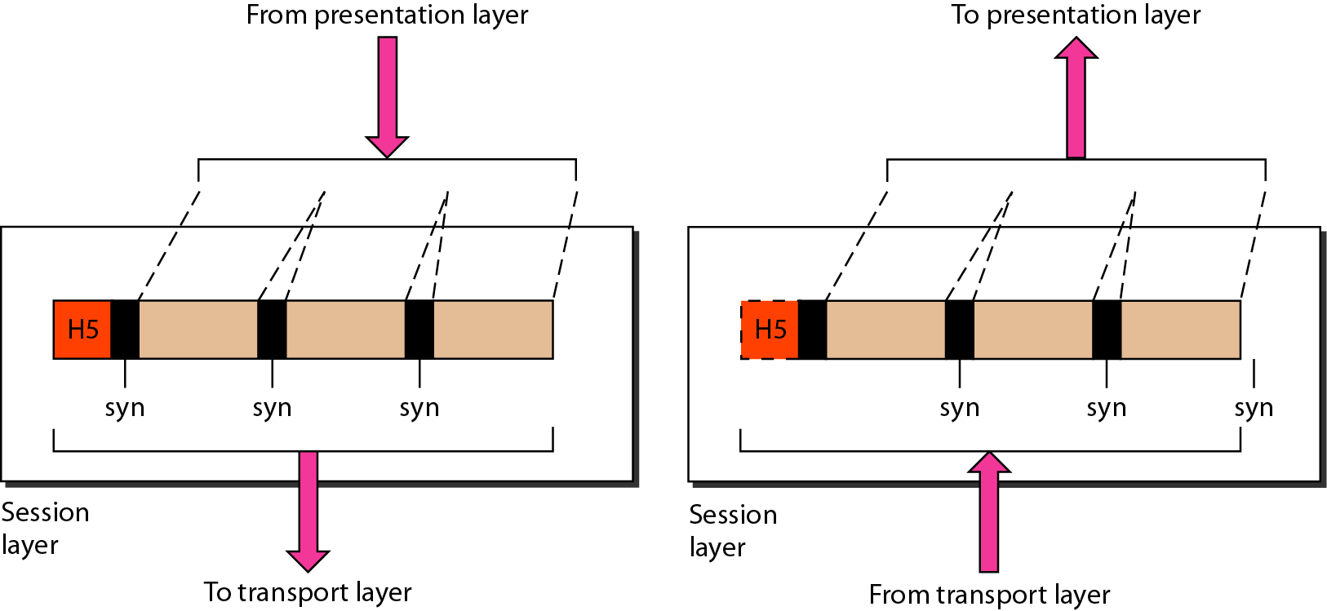
LAYER 5: SESSION
The session layer is responsible for dialog
control and synchronization.

Slide 43
LAYER 5: SESSION
The session layer defines how to start, control and end conversations (called sessions) between applications.
This includes the control and management of multiple bi-directional messages using dialogue control.
It also synchronizes dialogue between two hosts' presentation layers and manages their data exchange.
The session layer offers provisions for efficient data transfer.
Examples :- SQL (Structured Query Language), ASP(AppleTalk Session Protocol).

Slide 44
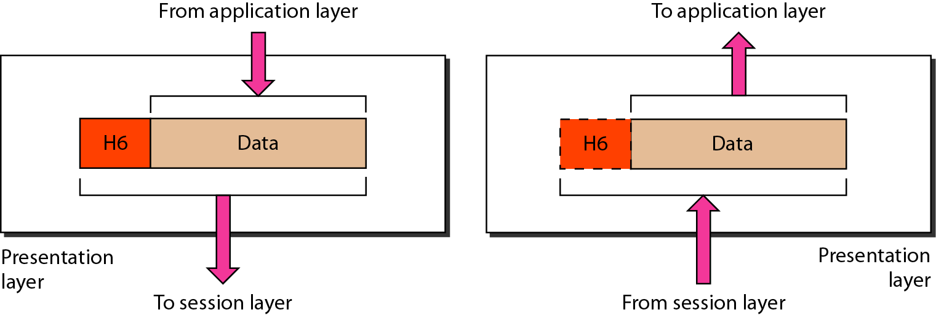
LAYER 6: PRESENTATION
The presentation layer is responsible for translation, compression, and encryption.

Slide 45
LAYER 6: PRESENTATION
The presentation layer ensures that the information that the application layer of one system sends out is readable by the application layer of another system.
If necessary, the presentation layer translates between multiple data formats by using a common format.
Provides protocol conversation , data translation , character set conversion ,the interpretation of graphics command , encryption and compression of data.
Examples :- JPEG, MPEG, ASCII, EBCDIC, HTML.

Slide 46
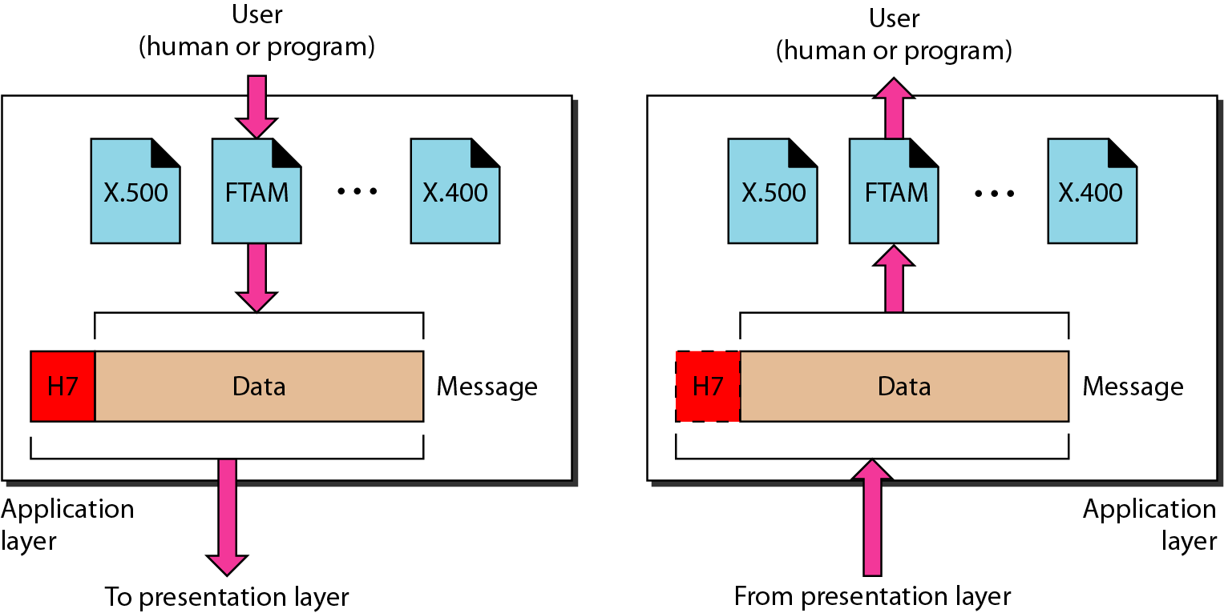
LAYER 7: APPLICATION
The application layer is responsible for
providing services to the user.

Slide 47
LAYER 7: APPLICATION
The application layer is the OSI layer that is closest to the user.
It provides network services to the user’s applications.
It differs from the other layers in that it does not provide services to any other OSI layer, but rather, only to applications outside the OSI model.
Examples of such applications are spreadsheet programs, word processing programs, and bank terminal programs.
The application layer establishes the availability of intended communication partners, synchronizes and establishes agreement on procedures for error recovery and control of data integrity.

Slide 48
LAYER 7: APPLICATION
Concerned with
  Network virtual terminal
  File transfer, access and management
  Mail services
  Directory services

Slide 49
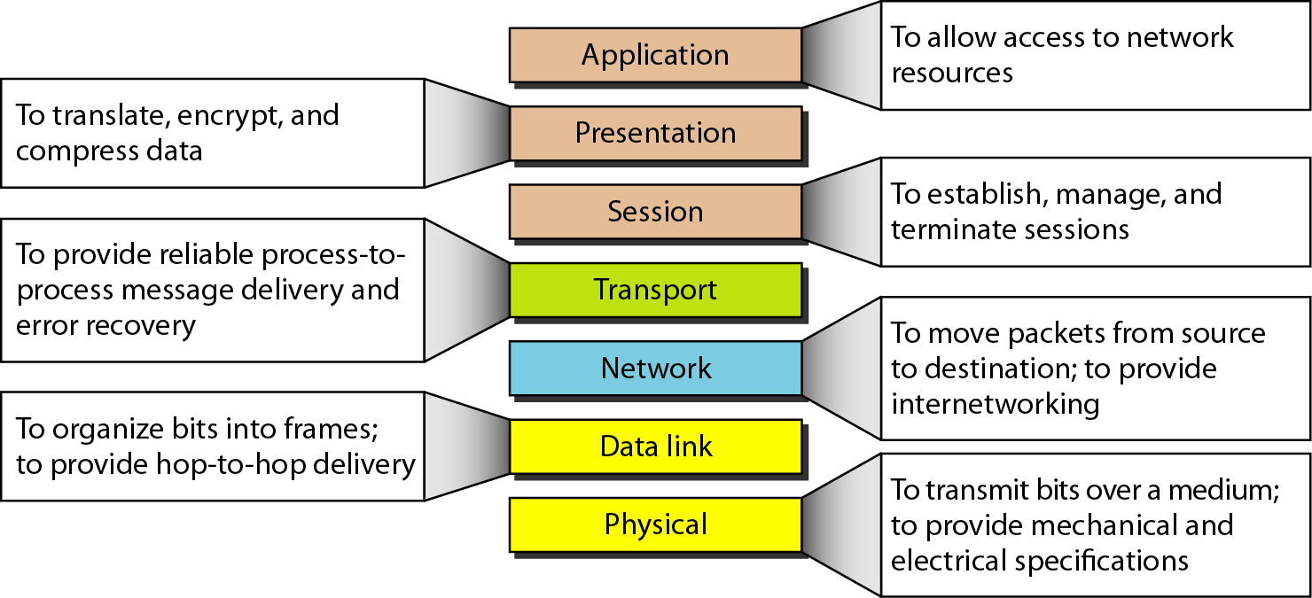
SUMMARY

Slide 50
SUMMARY
There was no standard for networks in the early days and as a result it was difficult for networks to communicate with each other.
The International Organisation for Standardisation (ISO) recognised this. and researched various network schemes, and in 1984 introduced the Open Systems Interconnection (OSI) reference model.
The OSI reference model has standards which ensure vendors greater compatibility and interoperability between various types of network technologies.
The OSI reference model organizes network functions into seven numbered layers.
Each layer provides a service to the layer above it in the protocol specification and communicates with the same layer’s software or hardware on other computers.
Layers 1-4 are concerned with the flow of data from end to end through the network and Layers 5-7 are concerned with services to the applications.

Slide 51
TCP/IP PROTOCOL SUITE
The layers in the TCP/IP protocol suite do not exactly match those in
the OSI model.
The original TCP/IP protocol suite was defined as having four layers:
  host-to-network
  internet
  transport
  and application.
However, when TCP/IP is compared to OSI, we can say
that the TCP/IP protocol suite is made of five layers:
  physical
  data link
  network
  transport
  and application.

Slide 52
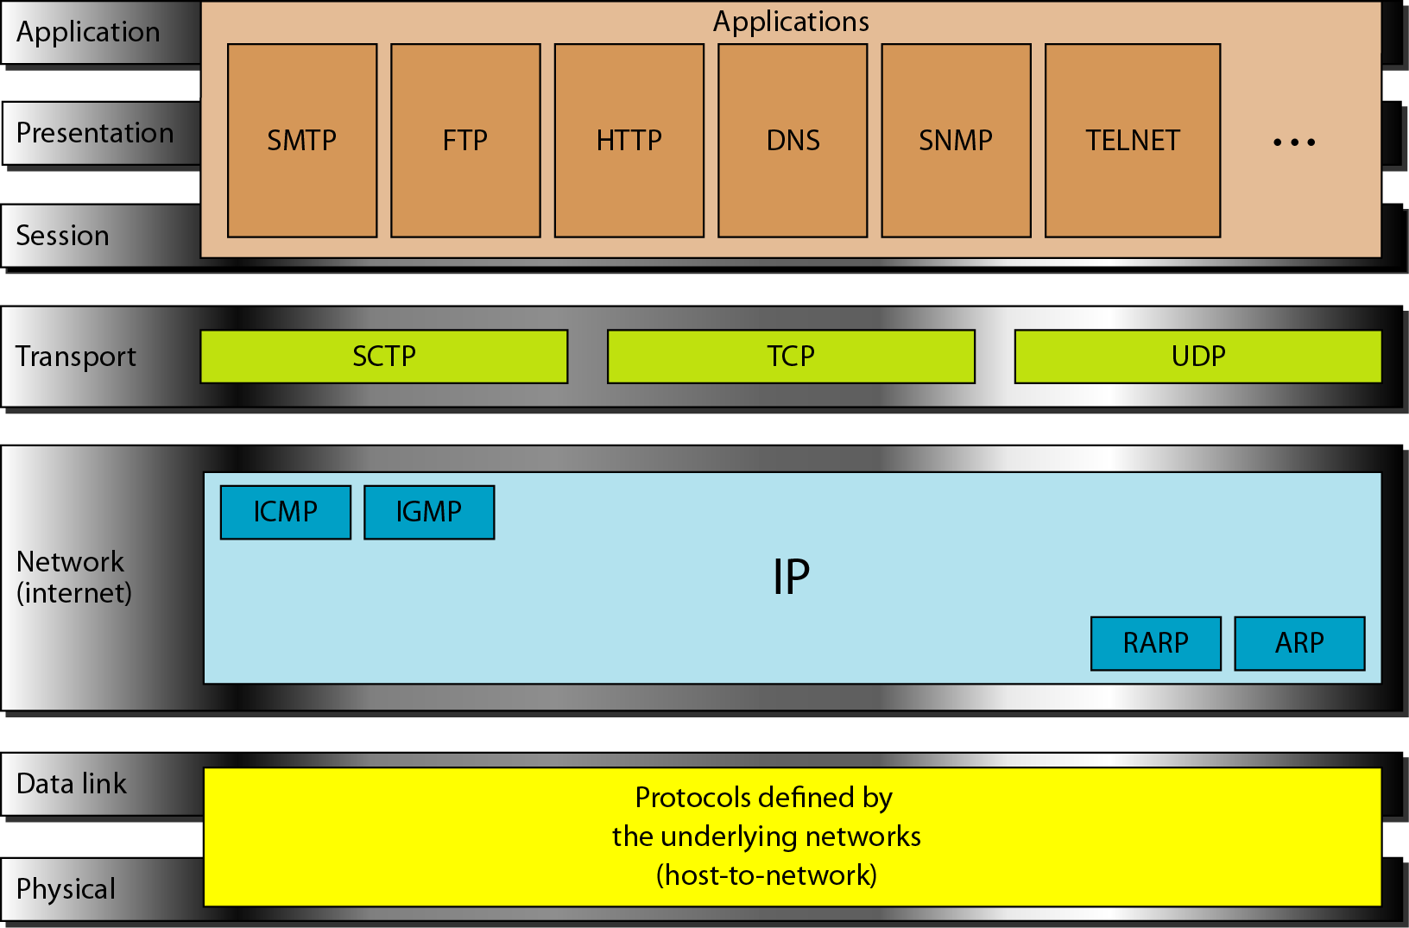
TCP/IP PROTOCOL SUITE

Slide 53
ADDRESSING
Four levels of addresses are used in an internet employing the TCP/IP protocols:
  physical,
  logical,
  port,
  and specific.

Slide 54
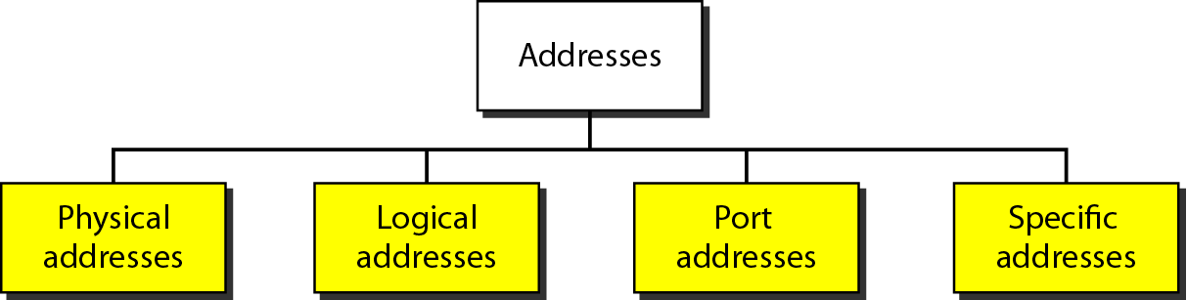
Addresses in TCP/IP

Slide 55
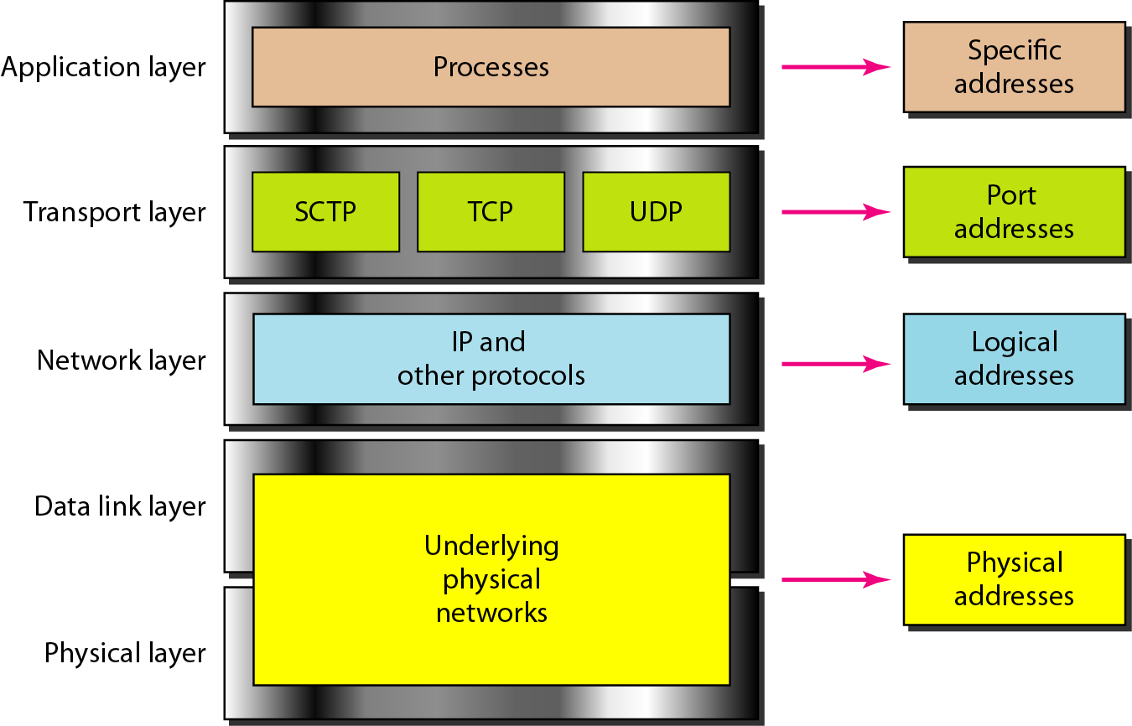
Relationship of layers and addresses in TCP/IP

Slide 56
Example 2.1
In Figure 2.19 a node with physical address 10 sends a frame to a node with physical address 87. The two nodes are connected by a link (bus topology LAN). As the figure shows, the computer with physical address 10 is the sender, and the computer with physical address 87 is the receiver.

Slide 57
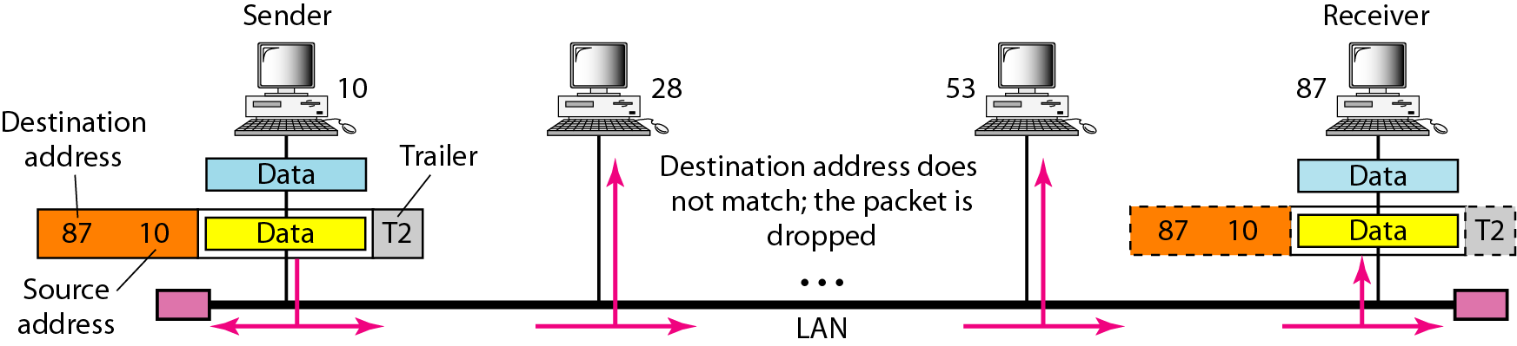
Figure 2.19 Physical addresses

Slide 58
Example 2.2
As we will see in Chapter 13, most local-area networks use a 48-bit (6-byte) physical address written as 12 hexadecimal digits; every byte (2 hexadecimal digits) is separated by a colon, as shown below:
07:01:02:01:2C:4B
A 6-byte (12 hexadecimal digits) physical address.

Slide 59
Example 2.3
Figure 2.20 shows a part of an internet with two routers connecting three LANs. Each device (computer or router) has a pair of addresses (logical and physical) for each connection. In this case, each computer is connected to only one link and therefore has only one pair of addresses. Each router, however, is connected to three networks (only two are shown in the figure). So each router has three pairs of addresses, one for each connection.

Slide 60
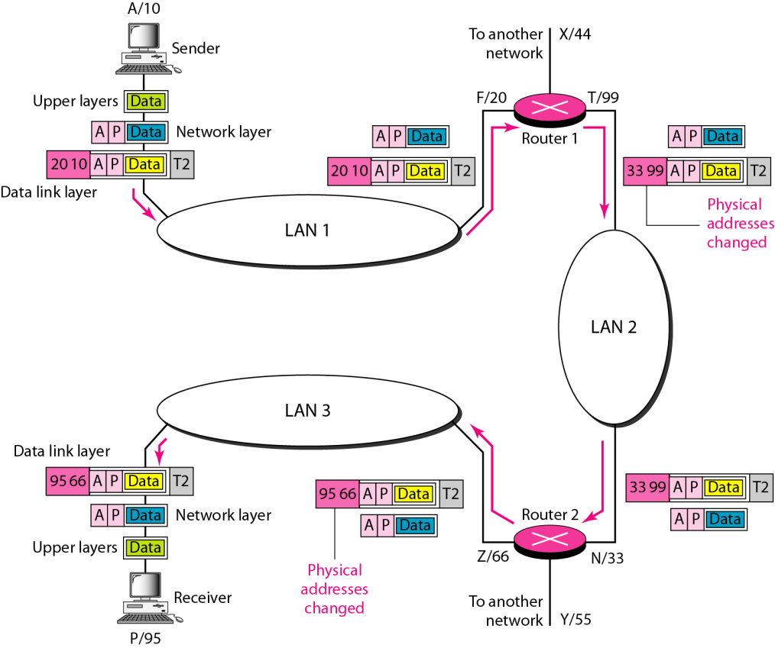
Figure 2.20 IP addresses

Slide 61
Example 2.4
Figure 2.21 shows two computers communicating via the Internet. The sending computer is running three processes at this time with port addresses a, b, and c. The receiving computer is running two processes at this time with port addresses j and k. Process a in the sending computer needs to communicate with process j in the receiving computer. Note that although physical addresses change from hop to hop, logical and port addresses remain the same from the source to destination.

Slide 62
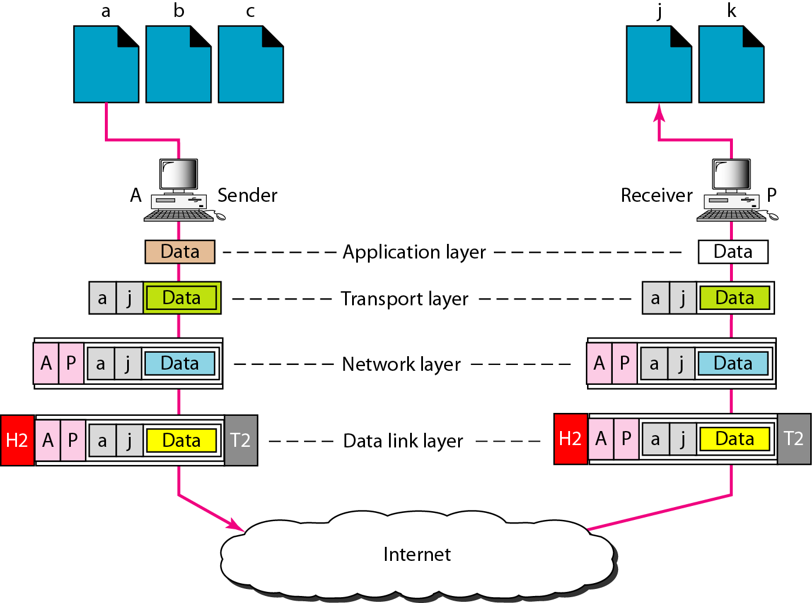
Figure 2.21 Port addresses
The physical addresses will change from hop to hop,
but the logical addresses usually remain the same.

Slide 63
Example 2.5
As we will see in Chapter 23, a port address is a 16-bit address represented by one decimal number as shown.
The physical addresses change from hop to hop,
but the logical and port addresses usually remain the same.

Slide 64

Questions?

